Slide 1
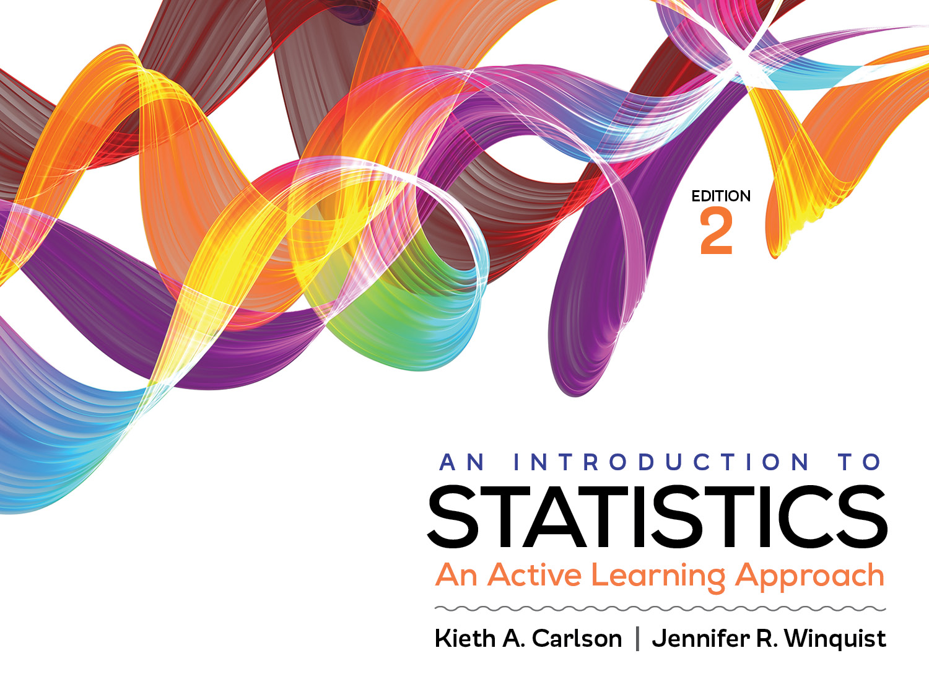
Introduction to Activity 10.5
Confidence intervals for mean differences between independent samples

Slide 2
Activity 10.5 will require you to:
Compute and interpret confidence intervals for means and mean differences between independent samples
Recognize the distinct purposes of significance testing, effect sizes, and confidence intervals
Complete APA-style statistical reports that include significance testing results, effect sizes and confidence intervals

Slide 3
Purposes of statistical procedures
Statistical procedure | Purpose
Significance testing | Decide if a treatment worked Determine if result is likely due to sampling error
Effect size | Describe how well a treatment worked
Confidence interval | Estimate a population parameter

Slide 4
Where to put the statistical information in APA summaries
Republicans were less disturbed by large income inequality in societies than Democrats.
(M = 19, SD = 1.0)
(M = 18, SD = 1.0)
CI [17.75, 18.25]
t (60) = 3.94
d = 1
95% CI [ .45, 1.55]
CI [ 18.75, 19.25]
p <.05
Place each of the statistical values to the left in the appropriate spot in this APA style write up.
Then, describe what each value means.
Notes:
Republicans (M = 18, SD = 1.0; 95% CI [17.75, 18.25]) were less disturbed by large income inequality in societies than Democrats. (M = 19, SD = 1.0; CI [ 18.75, 19.25]), t (60) = 3.94, p <.01, d = 1; CI [ .45, 1.55].

